Slide 1

DATA ENTRY TO FILE
📂
Presented by Group-Seven

Slide 2
Members in Group-Seven:-
- Mr. Gaurav Prajapati
Mr.Aditya Singh
Mr.Aditya Singh Shekhawat
Mr.Aditya Singh Tanwar
Mr.Aditya Tiwari
Mr.Ahad Ali

Slide 3
Introduction :-
Data Entry refers to the process of inputting, updating, and managing data into a computer system or database. It involves converting information from various sources—like paper documents, forms, or audio recordings—into a digital format.
This work is crucial in many industries including healthcare, finance, retail, education, and more, where accurate data is essential for operations, analysis, and decision-making.

Slide 4
There are different types of data entry tasks, such as:
Typing information into spreadsheets or databases
Transcribing audio files
Entering customer details or product information
Updating and maintaining electronic records
People who perform this job are called Data Entry Operators or Data Entry Clerks, and they typically need good typing skills, attention to detail,basic computer knowledge and data entry software required for handling data .

Slide 5
Usage of Data Entry software:-
Data entry software is used to make the process of entering, organizing, and managing data faster, easier, and more accurate. It helps individuals and businesses handle large volumes of information efficiently.
Main Uses of Data Entry Software:
Efficient Data Input
  Allows quick entry of data from various sources (manual, scanned, or digital).
  Supports forms, spreadsheets, or custom fields for structured data entry.
Error Reduction
  Features like auto-fill, spell-check, and validation rules help reduce typing mistakes.
  Real-time error detection ensures data accuracy.

Slide 6
.
.
3Data Organization
  Automatically stores entered data in databases or structured formats (like Excel, CSV).
  Makes sorting, filtering, and retrieving information easy.
4.Time-Saving
  Automates repetitive tasks (like copying data across files or updating records).
  Speeds up work with shortcuts, templates, and batch processing.
5.Integration with Other Tools
  1.Connects with CRM, accounting software, or cloud platforms for seamless data flow.
  2.Allows syncing with databases or spreadsheets in real time.
6.Security & Backup
  1.Protects sensitive data with user access controls and encryption.
  2.Offers backup and recovery options in case of data loss.

Slide 7
This Python program is a menu-driven file management system that allows users to perform basic file operations through a command-line interface.
🔧 Main Features:
Create a File – Make a new file and add content.
Read a File – View the contents of an existing file.
Write (Overwrite) a File – Replace the content of a file completely.
Append to a File – Add new content to the end of an existing file.
Exit – Close the program.
.
Tool used in program:-

Slide 8
⚙️ Core Concepts Used:
Functions for organizing tasks (e.g., create_file(), read_file()).
File Handling using modes like "x", "r", "w", and "a".
User Input via input() and menu navigation using if-elif statements.
Error Handling using try-except to catch invalid inputs and file errors.

Slide 9
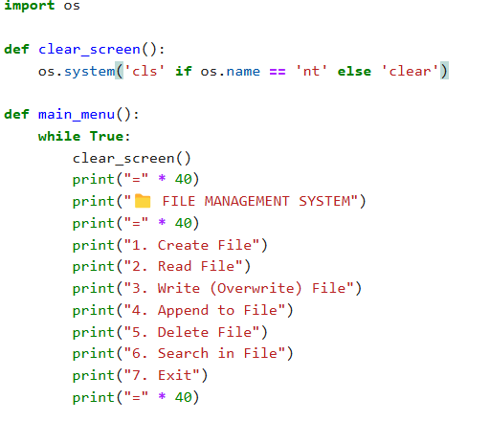
Program:-

Slide 10
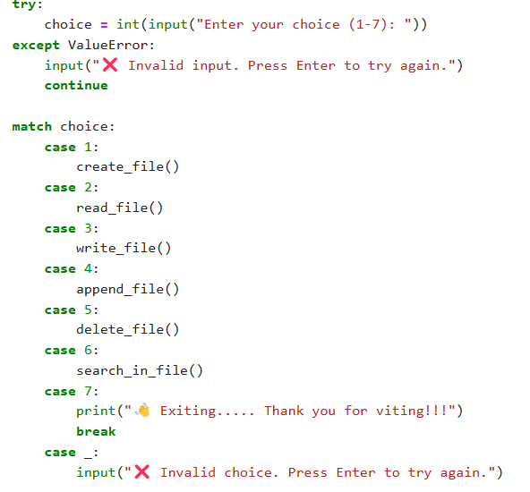

Slide 11
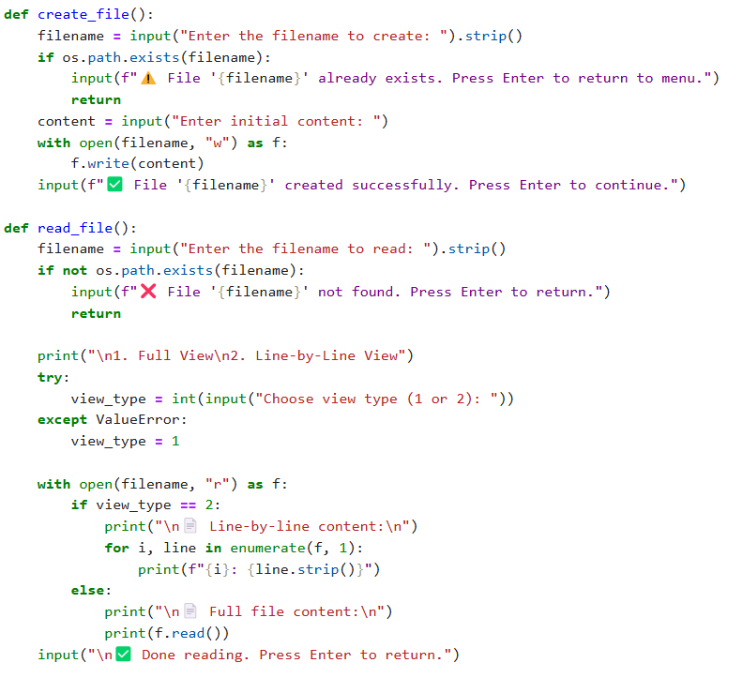

Slide 12
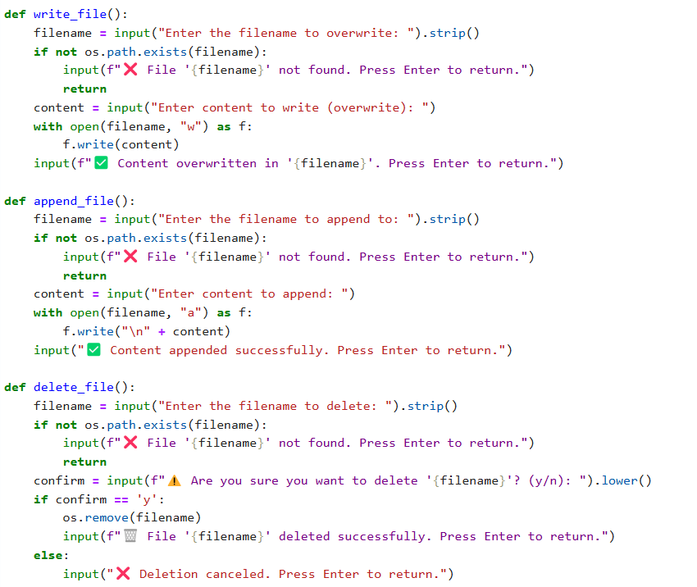

Slide 13
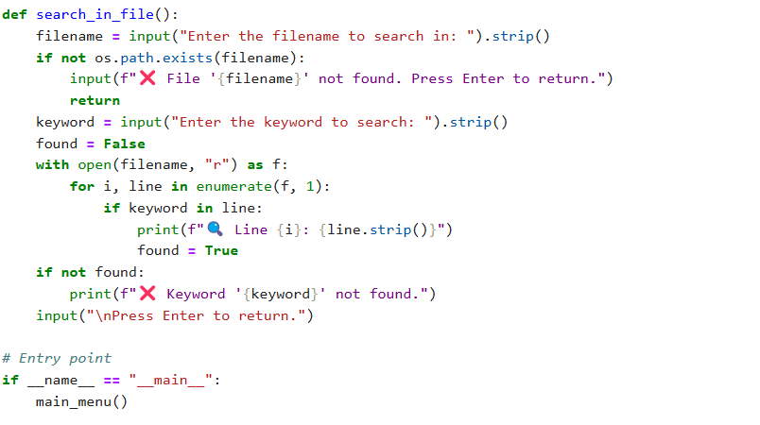

Slide 14
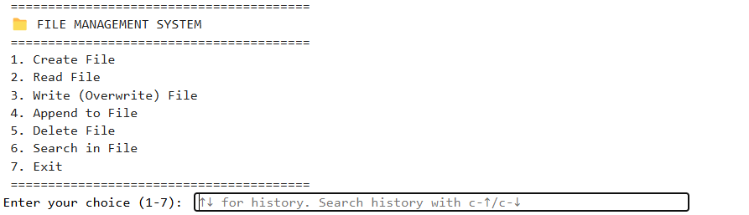
Output:-

Slide 15
This program is useful for learning how to work with files in Python, as well as for basic file management tasks in a text-based environment.
This useful in many type of offices and also useful in making file .
Some commonly using companies Microsoft Excel, Google Sheets, Zoho Forms, Airtable , Formstack, and industry-specific software like Tally (for accounting) or Epi Data (for research).
Summary:-

Slide 16
Thank you

